Slide 1
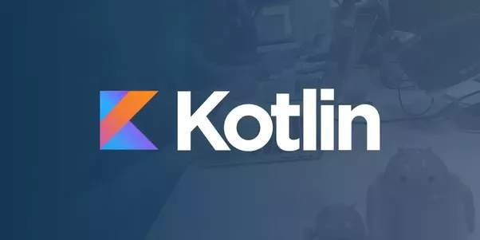
Jayashree S Kumar sk.jshree@gmail.com
March 24, 2018

Slide 2
AGENDA
What is Kotlin?
Growing Popularity
Why use Kotlin?
Distinguable feature overview
How is it written?
Building Blocks
Advantages & Disadvantages
Is it really THE java alternative?

Slide 3
What is Kotlin?

Slide 5
By JetBrains
Statically Typed
JVM Targeted
Open Source
OO & Functional Programing features
Interoperable with Java.
Ref: https://www.slideshare.net/abreslav/introduction-to-kotlin-brief-and-clear

Slide 6
Growing Popularity ...
Gradle Introduced as build scripts language
Evernote Integrated into their Android client
Uber Uses for building internal tools
Corda Built entirely
Coursera Android App Partially written
Atlassian New code on their APP
Pinterest
JetBrains!

Slide 8
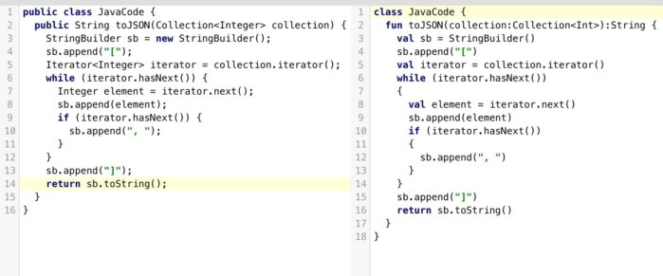
First Look...
Ref: https://www.infoworld.com/article/3224868/java/what-is-kotlin-the-java-alternative-explained.html

Slide 9
Hello, World!
fun main(args : Array<String>) {
val name : String = ”World"
println(“Hello, $name!”)
}
//Optional Semicolons
//namespace-level functions
// types on the right
// no special syntax for arrays

Slide 10
Why use Kotlin?

Slide 11
Concise
Drastically reduces the amount of boilerplate code you need to write.
Extension Functions, Higher order function , Lambdas, Singleton, data Classes etc.
Safe
Avoids entire classes of errors, such as NPE. Has very strong type inference, check for types and auto-cast.
Interoperable
Leverage existing frameworks and libraries of the JVM with 100% Java Interoperability.
Tool friendly
Works with major tools and services like: InteliJ IDEA, Android Studio, Eclipse. Uses build systems like Maven, Graddle and ANT.
Versatile
Build Server side application, Mobile Apps or front ended code running in the browser.

Slide 12
Creating POJO
class Person { private String name; public Person(String name) { this.name = name; } public String getName() { return name; } public void setName(String name){ this.name = name; } // toString... hashCode... equals... copy... } public static void main(String[] args) { String name = "Jay"; Person person = new Person(name); System.out.println(person.getName()); }
data class Person(val name: String)
fun main(args: Array<String>) { val name = "Jay" val person = Person(name) println(person.name) }
K
O
T
L
I
N
J
A
V
A

Slide 13
Singleton
public class Singleton {
private static Singleton instance = null;
private Singleton(){
}
private synchronized static void createInstance() {
if (instance == null) {
instance = new Singleton();
}
}
public static Singleton getInstance() {
if (instance == null) createInstance();
return instance;
}
}
object Singleton
K
O
T
L
I
N
J
A
V
A

Slide 14
Collections
class MyUtils{ static void example() { List<String> os = Arrays.asList("Android", "iOS", null, "Windowsph"); List<String> osNotNull = new ArrayList<>(); for (String name : os){ if (name != null) osNotNull.add(name); } Collections.sort(osNotNull, new Comparator<String>(){ @Override public int compare(String l, String r){ return l.length() - r.length(); } }); for (String name : osNotNull) { String value = name.toUpperCase(); print(value); } } }
val os = listOf("Android", "iOS", null, "Windowsph")
os.filterNotNull().sortedBy { it.length } .map { it.toUpperCase() } .forEach { print(it) }
K
O
T
L
I
N
J
A
V
A

Slide 15
How to code??
Build Blocks..

Slide 16
DEMO
Functions
Variables
String Interpolation
Conditional expression
when expression
For loop, while & do..while
Class and inheritance
Null Safety
Smart type checks
Extension Function
Lambda Expression

Slide 18
Advantages:
1. EASY
2. 100% Interoperable with Java
3. Choice of Programming philosophy
4. Null Safety
5. Aggressively Type inferred
6. Reduces Boilerplate Code
7. Modern & Elegant Syntax
8. Good Tools
Disadvantages:
Extra Runtime Size
Slow Build Time
Initial Code readability
Longer wait-time

Slide 19
Kotlin –
“The” Java Alternative?

Slide 22
Thank You!!

